Slide 1
Wireless E-Stop
Making lives easier

Slide 2
Purpose:
To create a more convenient method of stopping the rover

Slide 3
Explanation of ROle:
The wireless e-stop will consist of two different parts: the receiver and the transmitter
The receiver will be inside the rover and attached to the BMS
The transmitter will be a handheld device that can be used to e-stop the rover from a distance

Slide 4
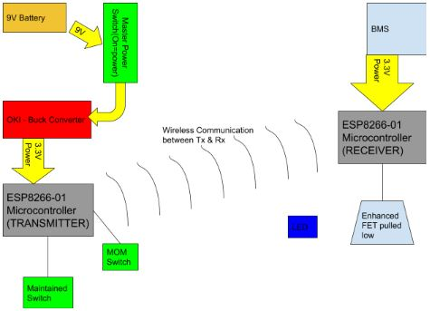
Block Diagram
This diagram shows the overall design of the proposed transmitter and receiver.
The master power switch must be on for the transmitter to function
The other two switches are used to perform the E-Stop.
The receiver…

